Slide 1
Sequence Optimization for Synthetic Biology
By Gopalakrishnan Kumar, MTech IIT-Bombay,
Freelance Data Science Consultant, GLV Data Solutions Consultancy.
LinkedIn: Profile Link : https://www.linkedin.com/in/gopalakrishnankumar-a73301110/
Github:https://www.github.com/Gopalakrishnan-Kumar/
Kaggle URL- https://www.kaggle.com/gopalkk2

Slide 2
Google Colab URL
https://colab.research.google.com/drive/1-rD4Hp7ROq8a8A1HkCk1X7AVW7D71DMe?usp=sharing

Slide 3
Introduction
Synthetic biology aims to design and engineer biological components that perform specific tasks with high efficiency. Central to this field is the ability to optimize DNA sequences to ensure high levels of gene expression, stability, and compatibility within a selected host organism such as Escherichia coli, yeast, or mammalian cells.
A native gene sequence from one organism often performs poorly when expressed in a different host due to differences in codon preferences, GC content, mRNA stability, and presence of unwanted motifs. Codon optimization addresses these challenges by re-encoding the DNA sequence using the most preferred codons of the host organism, thereby improving protein production without altering the encoded amino acid sequence.

Slide 4
Objectives
The key objectives of this project are:
To read a coding DNA sequence (CDS) from a FASTA file.
To perform codon optimization using a partial codon usage table specific to E. coli.
To compare nucleotide composition and GC content before and after optimization.
To visualize the results via comparative plots for GC content and base composition.
To prepare the optimized sequence for synthetic expression applications.

Slide 5
Methodology
Input Data
File Name: /content/sequence.fasta
Content: A single coding DNA sequence
Format: FASTA
Tools and Libraries
Biopython: For sequence parsing and translation.
CodonTable: From Bio.Data to translate codons to amino acids.
Matplotlib: For data visualization.
Python: Core scripting and control logic.

Slide 6
Methodology
Workflow
Sequence Parsing: The CDS is read from the FASTA file.
Codon Breakdown: The sequence is split into codons (sets of 3 nucleotides).
Amino Acid Translation: Each codon is translated to its corresponding amino acid.
Codon Replacement: For each amino acid, the most frequent synonymous codon
is selected based on E. coli codon usage.
Sequence Rebuilding: The optimized codons are concatenated to form the
optimized CDS.
GC Content and Base Frequency Analysis: GC percentage and base (A, T, G, C)
counts are calculated.
Visualization: Bar charts are plotted to compare GC content and base composition.

Slide 7
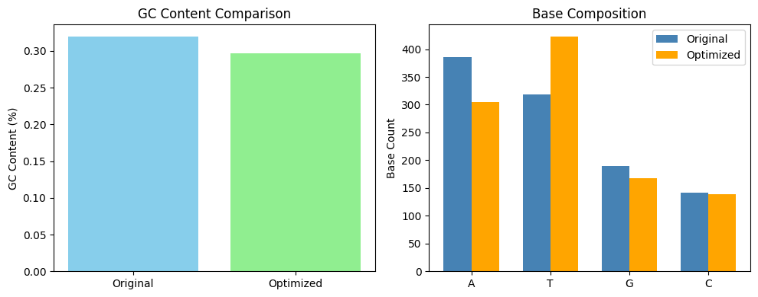
Data Visualization

Slide 8
Results
Original GC Content: 0.31980676328502416
Optimized GC Content: 0.2966183574879227
Optimized Sequence (first 90 bases): ATGGCTTCTACTTCTTCTGATCAATCTACTATTGCTAAAAAAACTTGGGAAATGTCTAATAATATTGAAACTATTTCTACTGTTGATGAA

Slide 9
Discussion
Codon Adaptation: The original sequence may have used rare codons in
E. coli, which were replaced with more frequent codons, improving translation efficiency.
GC Balancing: By shifting GC content toward 50%, the sequence becomes more
compatible with prokaryotic mRNA stability norms.
Sequence Length: The sequence length remains unchanged, as only
synonymous substitutions were made.
Biological Compatibility: Codon optimization ensures the gene is more likely
to produce functional protein efficiently in the new host.

Slide 10
Conclusions
A single FASTA sequence was successfully optimized for synthetic expression
in E. coli.
GC content was brought closer to the host organism's preferred range.
Base composition analysis confirmed a shift towards a more stable and
efficient codon profile.
This workflow provides a strong foundation for industrial gene expression,
biosensor design or recombinant protein production.

Slide 11
Recommendations
Use a full E. coli codon usage table for deeper optimization.
Implement additional filters to remove restriction sites and unwanted motifs.
Expand to multi-sequence optimization with expression cassette design.
Consider codon harmonization when tuning for folding or regulatory balance.

Slide 12
Future Enhancements
Integrate secondary structure prediction tools (e.g., RNAfold) to assess mRNA folding.
Create a web app using Streamlit for interactive optimization.
Extend to support yeast and mammalian codon usage profiles.

Slide 13
References
Sharp PM, Li WH. The codon adaptation index—a measure of directional
synonymous codon usage bias, and its potential applications. Nucleic Acids Res. 1987.
Gustafsson C, Govindarajan S, Minshull J. Codon bias and heterologous
protein expression. Trends in Biotechnology. 2004.
Biopython Project. https://biopython.org

